Slide 1


Slide 2




Overview
Blockchain Technology is more than a technology which is emerging rapidly and has a vast scope in the future. Blockchain acts as a financial network, software, distributed ledger, etc. Owing to this multitude of benefits and features, companies are now shifting their centralized and traditional working system to this trending and futuristic technology “Blockchain”.
Blockchain Council creates an environment and raise awareness among businesses, enterprises, developers, and society by educating them in the Blockchain space. We are a private de-facto organization working individually and proliferating Blockchain Technology globally.
Blockchain Council is an authoritative group of subject experts and enthusiasts who are evangelizing the Blockchain Research and Development, Use Cases and Products & Knowledge for the better world.
Blockchain Instructors
Toshendra Sharma ( Founder & CEO )
Blockchain Researcher, Developer & Consultant. Founded Allchains, Blockchain-as-a-Service Company. Earlier founded SaaS-based mobile application security company Wegilant (Appvigil). I am very passionate about new technologies like Blockchain, IOT, Application Security, AI etc. I am also the part of Forbes 30 Under 30 list of 2016 in Technology.
He is a well-known instructor & speaker in Blockchain space and taught more than 12,000 students worldwide spread in 148+ countries.
Rohendra Singh ( CTO )
Programmer, Technologist, Developed SaaS based scalable products & lead 20+ people tech team. Ex-VP Engineering at Wegilant (Appvigil).

Slide 3
About CBE Certification
The Certified Blockchain Expert is a skilled professional who understands and knows in-depth what is Blockchain and how Blockchain works and also uses the same knowledge to build Blockchain-based applications for enterprises and businesses. The CBE credential certifies individuals in the Blockchain discipline of Distributed Ledger Technology from a vendor-neutral perspective.
Certified Blockchain Expert is an exhaustive training, lab & exam based program aim to provide a proof of the knowledge of the certificate holder in Blockchain space. The Blockchain is evolving very fast & enabling businesses to build compelling solutions at a lesser cost. Enterprises are struggling to identify the right talent to deploy on the Blockchain-based projects in-house.
The Objectives of CBE Credentials are
  To establish and govern minimum standards for credentialing professional Blockchain expert as it specializes in enterprise development measures.
  To inform the public that credentialed individuals meet or exceed the minimum standards.
  To reinforce Blockchain expertise as a unique and self-regulating profession
Who can go for this course?
  All the students who are keen to learn about Blockchain Technology and their use-cases.
  10+2 students from all the streams can go for this training and certification.
How this certification will benefit students in their career?
Additional Benefits
Why students learn about Blockchain Technology?

Slide 4
Requirements
  Basic knowledge of Computer
  Must be motivated enough to learn Blockchain in-depth
Duration
  3-4 Hours of self-placed training
  1 hour for the exam
  Training can be consumed as per candidate’s availability & speed.
Venue
  Training & Exam both will be online
  Training can be taken remotely
Examination
  There will be an online multiple choice exam of 100 marks followed by the training.
  You need to acquire 60+ marks to clear the exam.
  If you fail the exam you can retake the exam again after 1 day.
  You can take the exam at the maximum of 3 times.
  If you failed to acquire 60+ marks Blockchain Council will provide you extra attempts and assistants to clear the exam.

Slide 5
Course Syllabus
At a broad level you will be attending the training which will cover below topics:
  Introduction
  What is Blockchain in real life?
  Why is Blockchain better than traditional technologies?
  Benefits of using Blockchain
    Provenance
    Consensus
    Security
    High Availability
    Finality
    Immutability
  Bitcoin & Blockchain: What is the relation?
  Ethereum & Smart Contracts
  Private vs Public Blockchain
  Why is it called a P2P network?
  Sample Transaction: How transaction gets executed & distributed?
  Consensus: How conflicts are being resolved?
  When to Use a Blockchain & when not?
  What is Blockchain mining?
  What are Miners? What does a Miner do?
  Security: Why Blockchain is More Secure
  Attacks: How Blockchain Can Be Hacked
  Private Blockchain: Can I setup my Own Blockchain
  What are Some Different Blockchain Technologies?
    Ethereum
    MultiChain
    Hyperledger
    Stratis
    etc.
  Blockchain-as-a-Service
    Microsoft Azure
    IBM Bluemix
  Use Cases: Supply-chain
    Vendor Payment
    Inventory Management
    Asset Tracking
    Regulatory Audit & Security

Slide 6
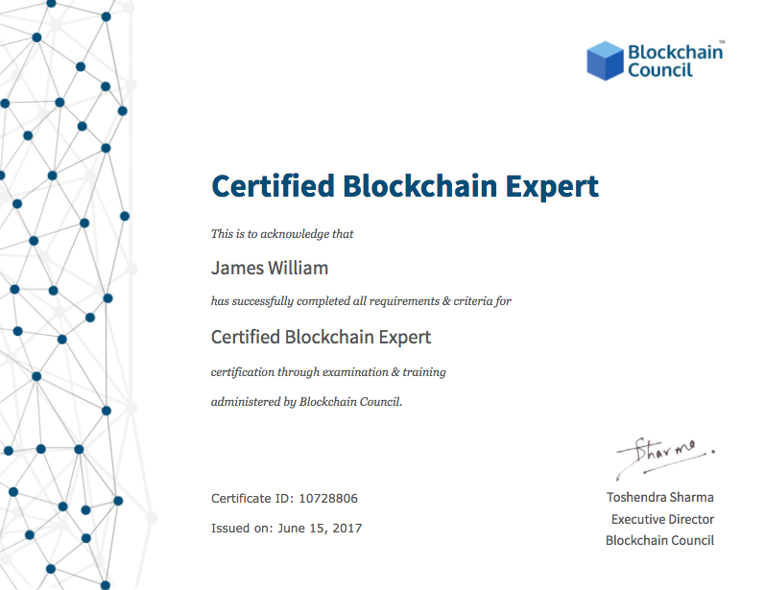
  Use Cases: Manufacturing
    Raw Material Tracking
    Invoice & Receipt Management
    Production Tracking
    Regulatory Audit & Security
  Use Cases: Healthcare Record Keeping
    Health Record Management
    Hospital Supply Tracking & Tracing
    Faster Claim Settlement
    Administrative & Regulatory Audit
    Equipment tracking
    Clinical Trials Record Keeping
  Use Cases: Music & Entertainment Industry
    Proof-of-Existence
    Digital Copyright
    Proof-of-Ownership
Sample Certificate

Slide 7
Why school students should go for our Blockchain Certification
Awareness about the latest technology
Career opportunities in the future
Can develop Blockchain based applications
It can increase their potential in getting hired easily in the near future
Can do internship on the Blockchain based projects
Certified students names will be displayed on our website
They can add their certified badge on various social media platforms such Linkedin
Benefits to the students after doing our Blockchain Certification
Free access to all the webinars conducted by us
Discount on all the Blockchain study material provided by such as ebooks
Free access to email training provided by us
Lifetime access to the certification training
Lifetime validity of the certificate issued by the Blockchain Council

Slide 8
Benefits to the institution
3 members within the organization with get free training and certification
1 year free access to the council membership
Email training
Certified members name will be displayed on our website

Slide 9
Commercials:
Based on
Online Training
Online training contains recorded training sessions of Instructors. In a one-long stretch, a student can complete course in 3-4 hours.
Cost – INR 6435/-
Upto 100 enrolments (10% Discount)
Upto 200 enrolments (20% Discount)

Slide 10
